Slide 1
My Own “Parallel Parser” for ”Paradox Game Data”
DongWook Lee
vztpv@naver.com

Slide 2
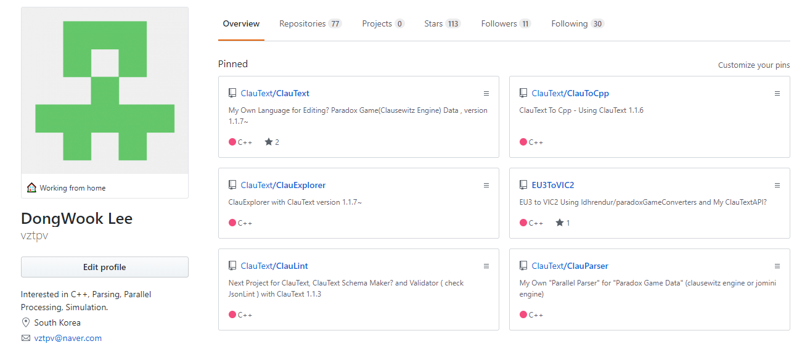
발표자 소개

Slide 3
목차
ParadoxGame and ParadoxGameData
Parallel Lexing(Scanning)
Parallel Parsing
Application

Slide 4

Paradox Game?

Slide 5
Paradox Game?
여기서는 Paradox Interactive 회사에서 클라우제비츠(clausewitz), jomini 엔진으로 만든 게임을 의미하며,
Paradox Parser는 이러한 게임 엔진으로 만든 게임의 텍스트 파일의 주된 스타일을 파싱합니다

Slide 6
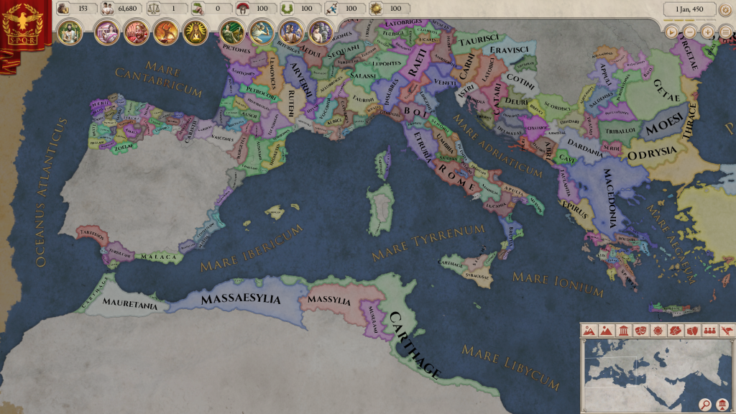
Jomini Engine

Slide 7

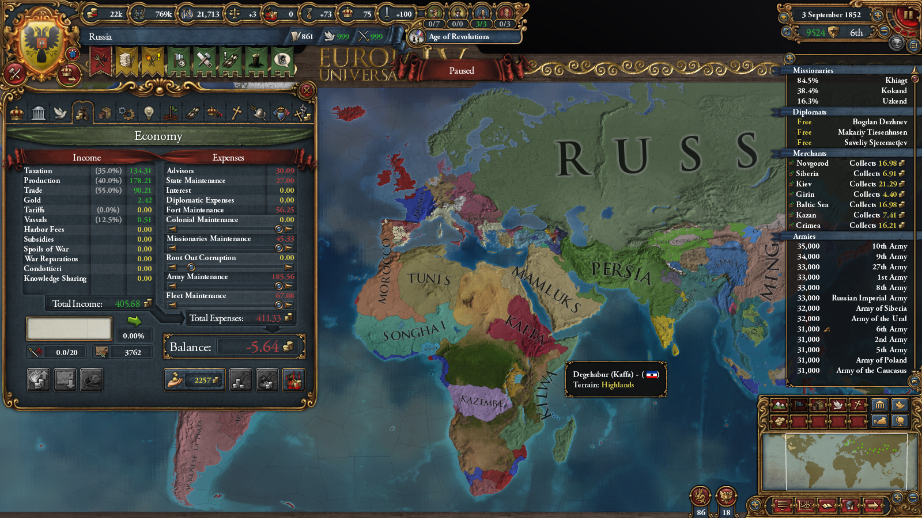
Clausewitz Engine

Slide 8
유로파 유니버셜리스4 (EU4)
역사 전략 시뮬레이션 게임
1444년 ~ 1821년 배경
매우 복잡함 (군사, 경제, 정치, 종교 등등)
진입장벽이 높음
세이브파일의 용량이 큼(30~60MB, 2백만줄)
다른 Paradox 게임도 세이브파일의 용량이 큽니다

Slide 9
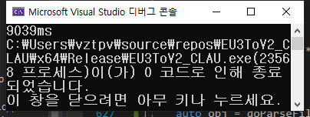
Other Parsers
Most Parsers are Very Slow for Large(>30MB) File
A Parser used in Idhrendur/paradoxGameConverters is Faster than most other parsers.
(test for 50MB)

Slide 10
My Grammar for “Paradox Game Data”
S -> A
A -> var = val A | var = { A } A | { A } A | val A | λ
var, val : 문자열!

Slide 11
“Paradox Game Data” vs JSON
# line comment
date=1947.5.8
save_game="Russia.eu4"
savegame_versions={
"1.18.1.0"
"1.18.2.0"
"1.18.3.0"
"1.18.4.0"
"1.19.1.0"
}
{
“date” : “1947.5.8”,
“save_game”:"Russia.eu4",
“savegame_versions”:[
"1.18.1.0",
"1.18.2.0",
"1.18.3.0",
"1.18.4.0",
"1.19.1.0"
]
}

Slide 12
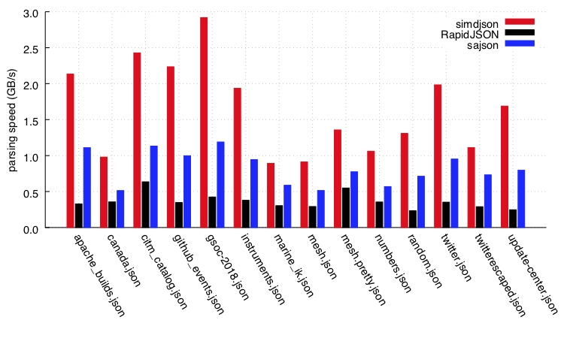
Other Parsers - Json Parsers
RapidJson - Sequential?, one of the fastest parsers
SimdJson - Parallel, 2~3 Times Faster than RapidJson

Slide 13
My Rule!
No Boost
No Regualr Expression Library
No std::string`s substr method
Postpone use of std::string

Slide 14
주의사항
데이터 순서가 중요함 - std::vector vs std::map
주석은 무시됨(in scanning)
중복된 key가 들어 올 수 있음

Slide 15
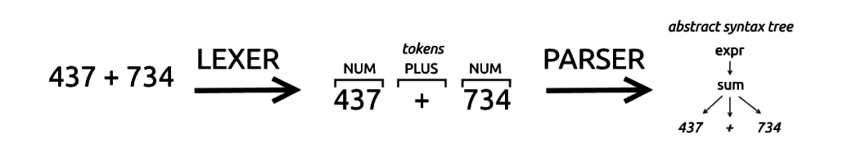
Parsing?
String -> Tokens -> Tree

Slide 16
“Parallel Parser”?
Parallel Scanning(Lexing)
Parallel Parsing
using std::thread

Slide 17
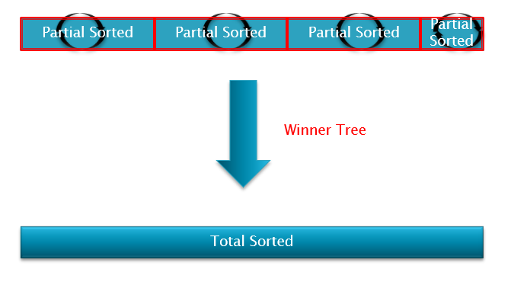
Parallel Sorting?
Divide, Partial Sorting, Merge

Slide 18
전체 과정
Scanners
Parsers
Text
Tokens
Tree

Slide 19
Loading Text From File
Scanners
Text
FILE

Slide 20
How to Read File?
std::vector<std::string> lines;
std::ifstream file; file.open(”test.txt”);
std::string str;
while (std::getline(file, str)) {
lines.push_back(str);
}
file.close();
return lines;

Slide 21
How to Read File!
char* buffer;
std::ifstream file; file.open(”test.txt”, std::ios::binary);
long long buffer_len = get_file_size(file);
buffer = new char[buffer_len + 1];
file.read(buffer, buffer_len); buffer[buffer_len] = ‘\0’;
file.close();
return buffer;

Slide 22
Convert Text to Tokens
Scanners
Text
FILE

Slide 23
How to Divide Text?
“ test = { } ”
# test2 = { }
엔터키(’\n')에 주목하자

Slide 24
Parallel Scanning - Assumption
“ “ quoted string must not have ‘\n’
“ abc \n def \n ghi “ # supported
“ abc
def
ghi “ # not supported

Slide 25
Parallel Scanning - Precautions
line comment(#) is not saved
data is divided by ‘\n’

Slide 26
Convert Text to Tokens
Scanners
Text
FILE

Slide 27
Scanning
따옴표로 둘러싸인 문자열 처리!
start state : 0
state == 0 and now char == ‘\”’ : state = 1
state == 1 and now char == ‘\”’ : state = 0
cf) “test \” test \” “
and parser support \”, but not support \\ , \\”

Slide 28
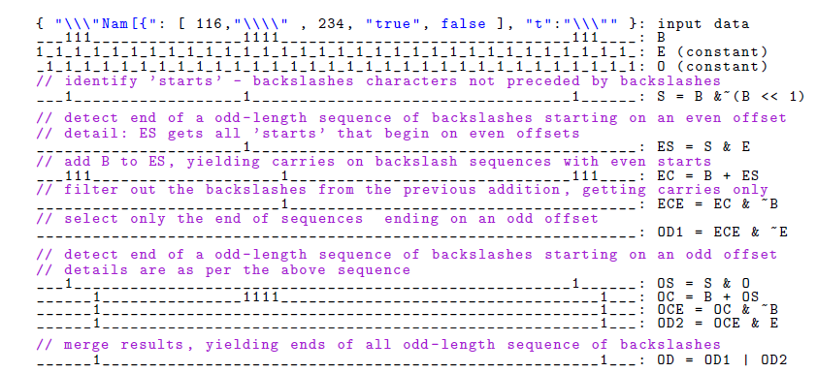
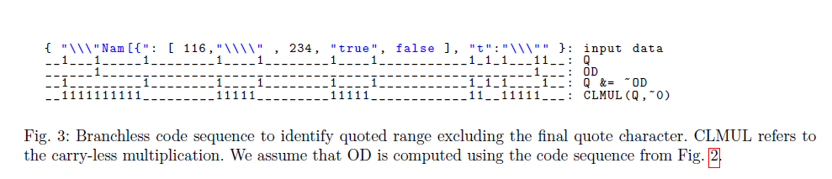
Revisit SimdJson?
Simd + Bit Operation
Using Bit Operation,
check {
check }
check “ { } “
check “ “
check “ \” \” “
check “\\“
but, check Line Comment?

Slide 29
How to Tokenize?
std::vector<std::string> lines;
std::ifstream file; file.open(”test.txt”);
std::string str;
while (std::getline(file, str)) {
lines.push_back(str);
}
file.close();
return lines;
class Token {
std::string str;
long type;
};
Token token = getToken();
in getToken function, maybe substr is used...

Slide 30
How to Tokenize?
char* buffer;
std::ifstream file; file.open(”test.txt”, std::ios::binary);
long long buffer_len = get_file_size(file);
buffer = new char[buffer_len + 1];
file.read(buffer, buffer_len); buffer[buffer_len] = ‘\0’;
file.close();
return buffer;
char* buffer = readFile(”filename.txt”);
long long token;
// 32 bit : start index of token in buffer
// 30 bit : length of token
// 2 bit : type of token
( 0 - general, 1 - {, 2 - }, 3 - = )
cf) std::string(buffer + GetIdx(token), GetLength(token));

Slide 31
Merging Tokens
Scanners
Text
Tokens

Slide 32
전체 과정
Scanners
Parsers
Text
Tokens
Tree

Slide 33
Tree구조
date=1947.5.8
save_game="Russia.eu4"
savegame_versions={
"1.18.1.0"
"1.18.2.0"
"1.18.3.0"
"1.18.4.0"
"1.19.1.0"
}

Slide 34
ItemType
Name
Data

Slide 35
ItemType
date = 2019.04.13
?
?

Slide 36
ItemType
date = 2019.04.13
ItemType<std::string> x
(”date”, “2019.04.13”);
std::cout << x.ToString();
date
2019.04.13

Slide 37
ItemType
“Hello Wiz”
?
?

Slide 38
ItemType
“Hello Wiz”
ItemType<std::string> x
(””, “Hello Wiz”);
std::cout << x.ToString();
empty str
“Hello Wiz”

Slide 39
UserType
Name

Slide 40
UserType
usertype = { }
?

Slide 41
UserType
usertype = { }
UserType global;
UserType ut(”usertype”);
global.AddUserTypeItem(ut);
std::cout << global.ToString();
usertype

Slide 42
UserType
{ }
?

Slide 43
UserType
{ }
UserType global;
UserType ut(””);
global.AddUserTypeItem(ut);
std::cout << global.ToString();
empty str

Slide 44
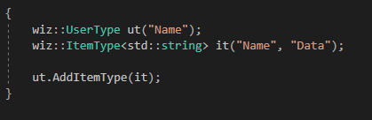
UserType can have ItemTypes
Name
Name
Data

Slide 45
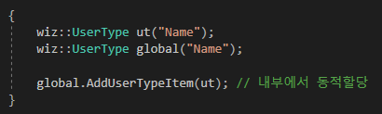
UserType can have (UserType*)s
Name
Name

Slide 46
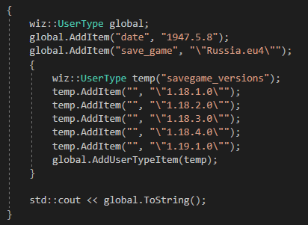
Tree구조
date=1947.5.8
save_game="Russia.eu4"
savegame_versions={
"1.18.1.0"
"1.18.2.0"
"1.18.3.0"
"1.18.4.0"
"1.19.1.0"
}

Slide 47
Parallel Parsing
Scanners
Parsers
Text
Tokens
Tree

Slide 48
Automata 0(1)*
1
0

Slide 49
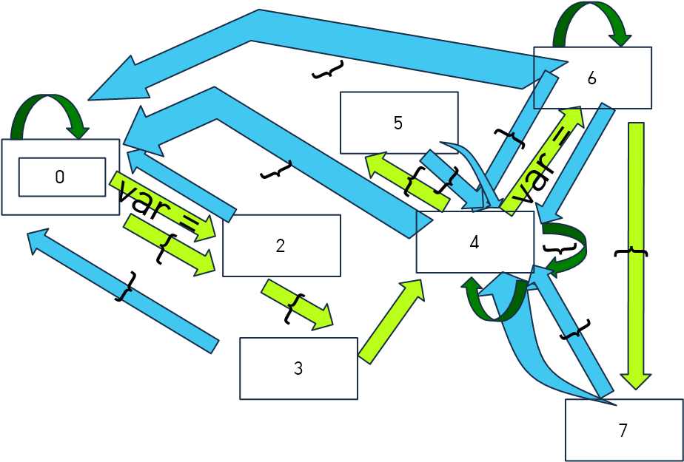
Parsing - Automata? (Old version)
} => state가 0 or 4
} 기준으로 토큰을 나누면 내부 state를 쉽게 알 수 있다.
S -> A
A -> var = val A |
var = { A } A |
{ A } A |
val A |
λ
var, val : 문자열!

Slide 50
Parsing - Automata (New, Simple version!)
S -> A
A -> var = B |
{ A |
} A |
val A |
λ
B -> val A | { A
var, val : 문자열!
{ , } , val
var =
{ , val

Slide 51
Parallel Parsing
Scanners
Parsers
Text
Tokens
Tree

Slide 52
Parallel Parsing - Divide
depth?
initial depth = 0;
if meet { : depth++;
if meet } : depth--;
A = { ~~~ } # here depth == 0
B = { ~~~ } # here depth == 0
C = { ~~~ } # here depth == 0 -> cf) 3 Files

Slide 53
Parallel Parsing - Divide, Old Version
A = {
B = {
1 2 3
} # divided here?
C = {
4 5 6
} # divided here?
} # divided here?

Slide 54
Parallel Parsing - Divide, New Version
1935.1.1={
advisor={
name="Fritjof Akeleye"
type=naval_reformer
skill=1
location=1
discount=no
date=1935.1.1
hire_date=1.1.1
female=no
id={
id=81577
type=51
}
}
}
{ , } , val
var =
{ , val

Slide 55
Virtual Node
x y z }
=> # = { x y z }
#
empty
empty
empty
x
y
z

Slide 56
Virtual Node의 특성
# = {} # = {} : does not exist!
# = { # = { # = { } } }

Slide 57
Virtual Node의 특성
input }
result # = { }
#

Slide 58
Virtual Node의 특성
input } {
result # = { } { }
#
empty str

Slide 59
Virtual Node의 특성
input } { }
result # = { } { }
#
empty str

Slide 60
Virtual Node의 특성
input } { } }
result # = { # = { } { } }
#
#
empty str

Slide 61
Merge
empty str
Global
_Global1
_Global2
_Global3
_Global4

Slide 62
Merge
1935.1.1={
advisor={
name="Fritjof Akeleye"
type=naval_reformer
}
}
1935.1.1={
advisor={
name="Fritjof Akeleye"
type=naval_reformer
skill=1
location=1
discount=no
date=1935.1.1
hire_date=1.1.1
female=no
id={
}
skill=1
location=1
discount=no
#={
#={
#= {
id=81577
type=51
}
}
}

Slide 63
Merge
1935.1.1={
advisor={
name="Fritjof Akeleye"
type=naval_reformer
skill=1
location=1
discount=no
1935.1.1={
advisor={
name="Fritjof Akeleye"
type=naval_reformer
skill=1
location=1
discount=no
date=1935.1.1
hire_date=1.1.1
female=no
id={
date=1935.1.1
hire_date=1.1.1
female=no
id={
}
#={
#={
#= {
id=81577
type=51
}
}
}

Slide 64
Merge
1935.1.1={
advisor={
name="Fritjof Akeleye"
type=naval_reformer
skill=1
location=1
discount=no
date=1935.1.1
hire_date=1.1.1
female=no
id={
1935.1.1={
advisor={
name="Fritjof Akeleye"
type=naval_reformer
skill=1
location=1
discount=no
date=1935.1.1
hire_date=1.1.1
female=no
id={
id=81577
type=51
}
}
}
#={
#={
#= {
id=81577
type=51
}
}
}

Slide 65
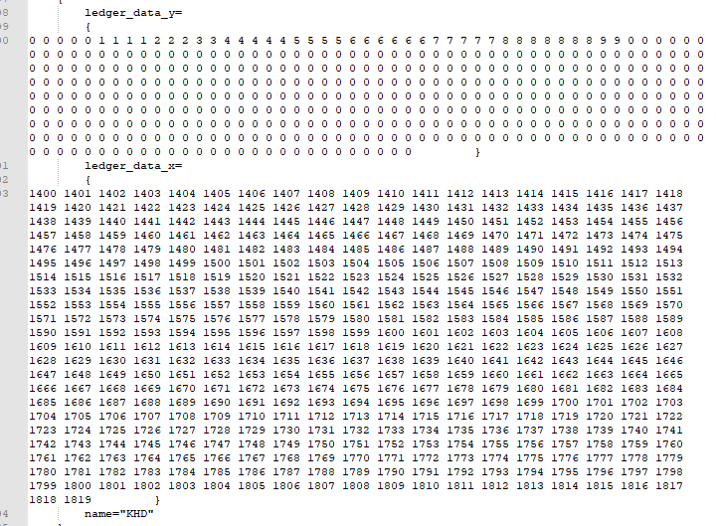
reserve를 활용하자 + push_back

Slide 66
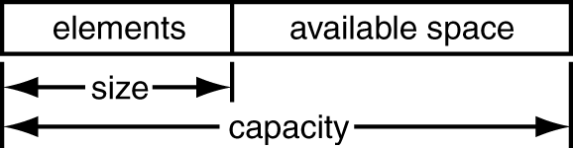
reserve를 활용하자 + push_back
A = { 1 2 3 ... 1024 } B = { 1 2 3 ... 1024 }
UserType A
UserType B
Token Array

Slide 67
reserve를 활용하자 + push_back
A = { 1 2 3 ... 1024 } B = { 1 2 3 ... 1024 }
UserType A
UserType B
Token Array

Slide 68
reserve를 활용하자 + push_back
A = { 1 2 3 ... 1024 } B = { 1 2 3 ... 1024 }
long long x;
// 32 bit : start index of token in buffer
// 30 bit : length of token
// 2 bit : type of token ( 0 - general, 1 - {, 2 - }, 3 - = )
cf) std::string(buffer + GetIdx(x), GetLength(x));
UserType A
임시 저장소
UserType B
Token Array

Slide 69
reserve를 활용하자 + push_back
A = { 1 2 3 ... 1024 } B = { 1 2 3 ... 1024 }
long long x;
// 32 bit : start index of token in buffer
// 30 bit : length of token
// 2 bit : type of token ( 0 - general, 1 - {, 2 - }, 3 - = )
cf) std::string(buffer + GetIdx(x), GetLength(x));
UserType A
임시 저장소
UserType B
Token Array

Slide 70
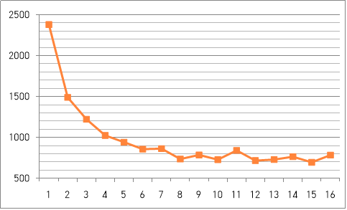
Thread개수별 걸린시간(ms) 비교
Intel 제온 프로세서
가상 CPU코어 24개
윈도우즈 서버 OS
SSD
Parsing 50MB Data

Slide 71
Parallel Paradox Parser의 문제점
다른 프로세스가 CPU를 차지하는 정도에 따라 성능차이가 크다.
예외처리?
UTF-8?

Slide 72
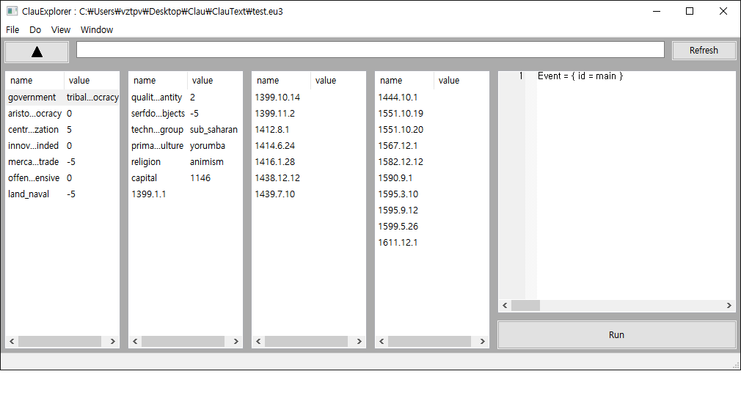
Related Project - ClauExplorer

Slide 73
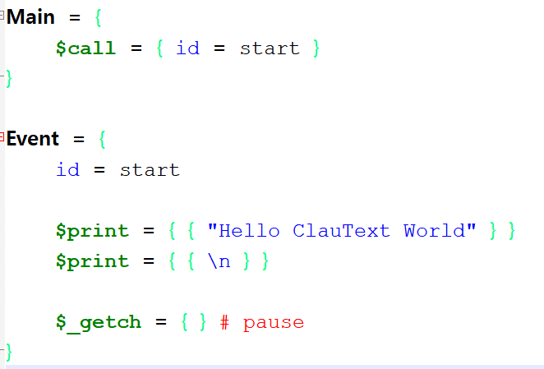
Related Project - ClauText

Slide 74
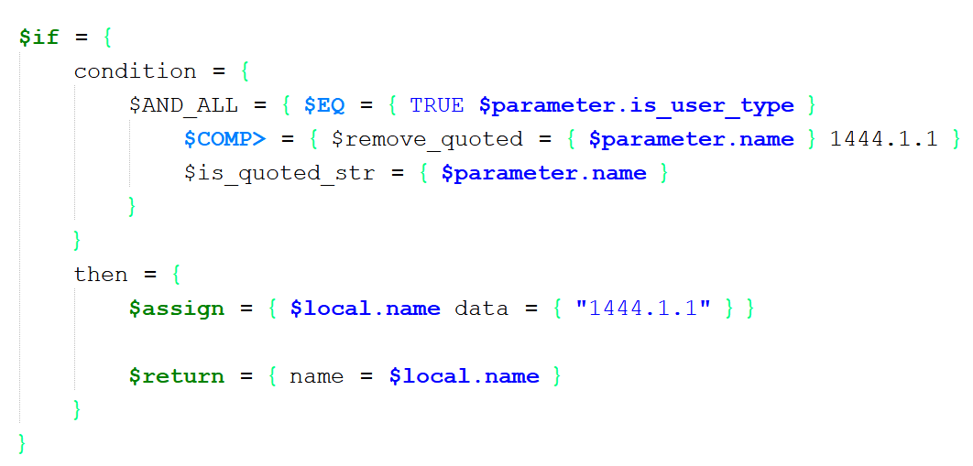
Related Project - ClauText

Slide 75
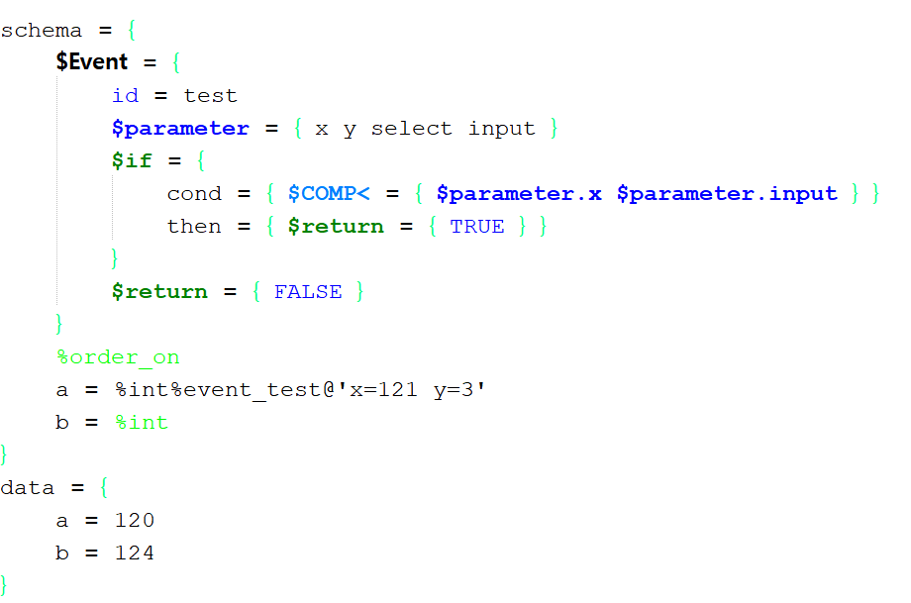
Related Project - ClauSemanticValidator in Clautext

Slide 76
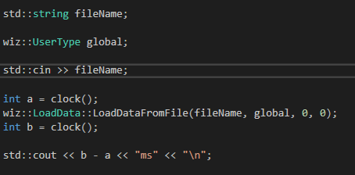
Usage - Load Data From File

Slide 77
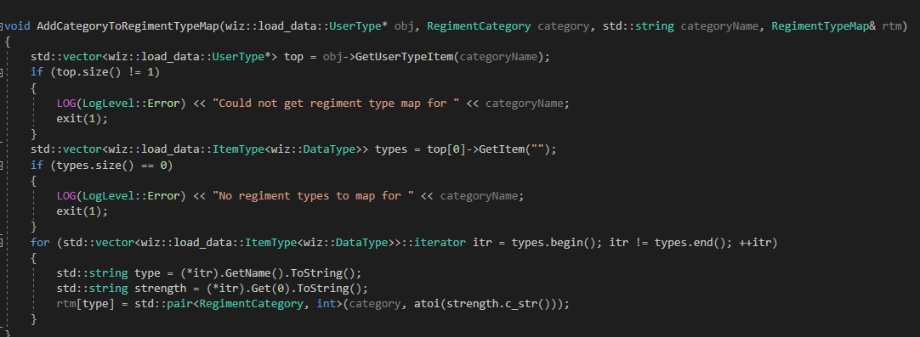
Usage - EU3 To Vic2

Slide 78
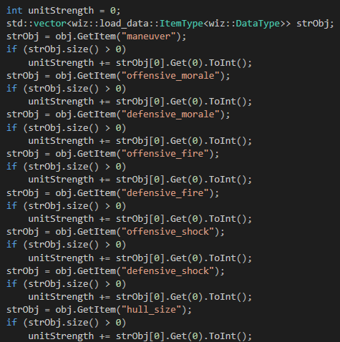
Usage - EU3 To Vic2
Name
Data

Slide 79
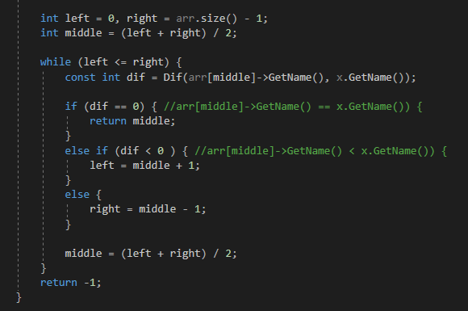
Etc..
int to string?
standard function is slow!
binary search?
use of std::string object.compare()
strcmp in c

Slide 80
레퍼런스
https://github.com/ClauText/ClauParser
SimdJson - https://github.com/lemire/simdjson
웹 브라우저에서의 효율적인 병렬 파싱 알고리즘 - http://www.dbpia.co.kr/journal/articleDetail?nodeId=NODE06228615&language=ko_KR
https://github.com/ClauText/ClauText
https://github.com/ClauText/ClauExplorer
https://github.com/vztpv/EU3ToVIC2

Slide 81
Q&A

Slide 82
감사합니다

